Slide 1
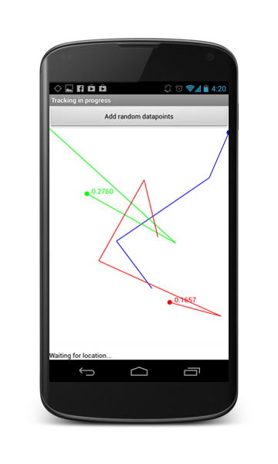
raceTrace
A real-time group tracking app
John Knox

Slide 2
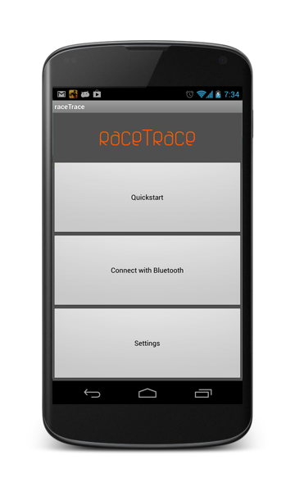
Session Setup
Two Methods:
Bluetooth
Coordinating server

Slide 3
Data Structure and Network Protocols
Data Structure
List of (location, time) pairs (indexed by distance moved) for each device
Stored as ordered tree of gapless segments of data
Client / Server
Peer to Peer
Data Requests

Slide 4
Next Steps
Built with logging functionality
Use recorded GPS traces to simulate real usage
Test various protocol combinations with increasing levels of packet loss
Analyse data from tests

